Slide 1
Relative Motion/Rotation
of Objects
“Hinge objects”

Slide 2
Last time on Dragonball Z...
We attached objects to other objects using the “Follow” metadata tag
Allows for Object-Oriented (OO) implementation of relative movement (one object moving relative to another
“Follow” objects either keep a fixed distance relative to their target (e.g. flight formation), or have a maximum but no minimum follow distance (e.g. following option minions)
We can ‘chain’ objects to create… A CHAIN!
Object A
Object B Follow A
Object C Follow B
… etc.

Slide 3
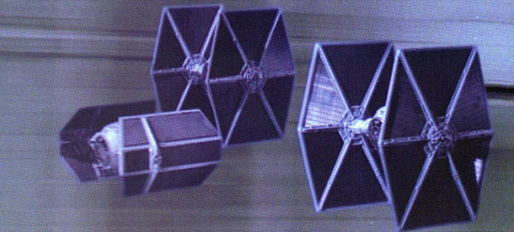
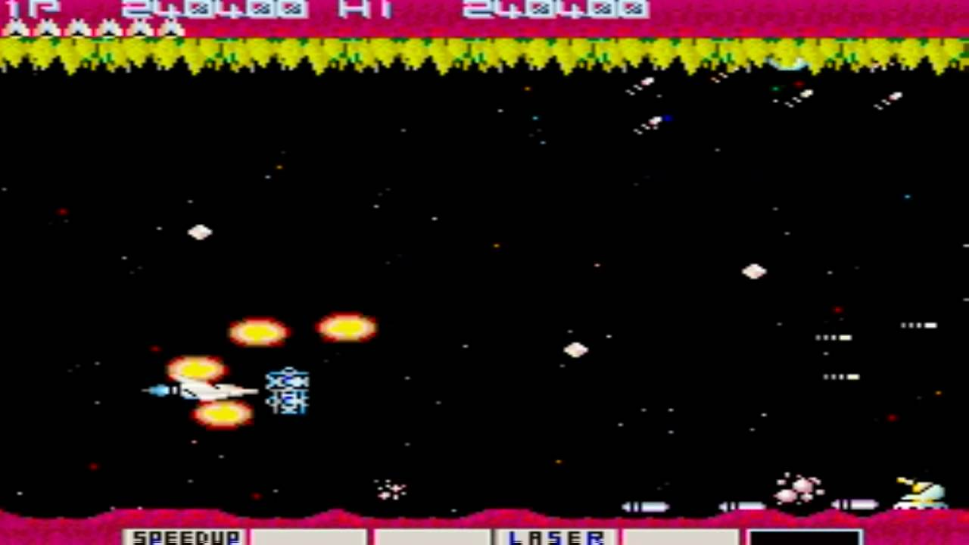
Examples
Following options (object chain)
Flight formation (fixed distance follow)

Slide 4
Chain Effect++: Motivation
We still want objects to “Follow” other objects, but we also want to incorporate rotation
Objects move relative to each other, but also rotate relative to a pivot
Chain objects together, combined with rotations = hierarchy chain

Slide 5
SDL code
Look in GameObject::render for the function call SDL_RenderCopy
Basic render function with position/size, sprite sheet, and clip area
SDL_RenderCopy(SDL_Renderer* renderer, SDL_Texture* texture, const SDL_Rect* srcrect, const SDL_Rect* dstrect)
Replace with SDL_RenderCopyEx

Slide 6
SDL_RenderCopyEx
SDL_RenderCopyEx(SDL_Renderer* renderer, SDL_Texture* texture, const SDL_Rect* srcrect, const SDL_Rect* dstrect, const double angle, const SDL_Point* center, const SDL_RendererFlip flip)

Slide 7
SDL_RenderCopyEx Arguments
renderer - target renderer (you already use this)
texture - texture to be rendered (you already use this)
srcrect - clip area of the texture
dstrect - position/width/height used when rendering the texture
angle - rotation angle (in degrees) to rotate the texture
center - 2d point to rotate the texture relative to (nullptr defaults rotate about center of texture)
flip - enum to SDL_FLIP_HORIZONTAL, SDL_FLIP_VERTICAL, or SDL_FLIP_NONE

Slide 8
Example
SDL_RenderCopyEx(renderer, texture, &clip, &pos, 0, nullptr, SDL_FLIP_HORIZONTAL)
Flip the texture horizontally (no other transforms)
SDL_Point center = {0, 0};
SDL_RenderCopyEx(renderer, texture, &clip, &pos, 90, &center, SDL_FLIP_NONE)
Rotate texture about its point (0,0) 90 degrees

Slide 9
Assignment
Switch over to using SDL_RenderCopyEx for your renders
Have your “Follow” objects orbit around their target objects
this->position = target->position + offset (offset is a fixed point that you hardcode)
center = -offset (center is an SDL_Point)
angle += rotationSpeed (angle is a float that increases every update

Slide 10
Intended Effect
Objects should rotate around their intended “Follow” target

Slide 11
Homework
Extend this to a chain hierarchy

